Slide 1
Open Enrollment 2024
Columbus consolidated government

Slide 2
Employee’s Responsibility
Please visit www.Neogov.com to complete your tobacco affidavit and wellness incentive forms. Visit www.columbus.bswift.gov/HR to obtain additional information regarding the tobacco Cessation Programs offered.
Review Open Enrollment Materials
Update personal and beneficiary information
Complete Enrollment via on-line enrollment system or with an enroller by the deadline, October 20th at 11:59 pm. NO EXCEPTIONS!!!!
Notify NFP at 1-844-505-9158 if you have problems enrolling in BSWIFT.
Review your first paycheck in 2024 to ensure you are having deductions for the benefits you enrolled in.

Slide 3
Qualifying Life Event Changes
What is a Qualifying Life Event (QLE)
  Marriage
  Divorce
  Birth of a child
  Loss of other coverage
  Loss of dependent status
30 days to notify Human Resources or NFP of the QLE
Appropriate documentation must be received before the change will become effective.

Slide 4
New for 2024
Employees that choose to participate in the wellness program by completing a Personal Health Assessment PHA and attend health coaching sessions (if required), will see no increase to their payroll deductions for medical coverage. Those that choose not to participate in the wellness program will additional 22% to their medical payroll deductions.
Employees will still have the opportunity to earn 1 Wellness Day and a $25 gift card by participating in a Personal Health Assessment
Telemedicine will continue to be offered by a benefit discount program through NewBenefits with no increase to deductions

Slide 5
Enrollment Guidelines
BEFORE YOU ENROLL - THINGS TO KNOW
You are REQUIRED to provide a copy of the below information / documentation for all new dependents/beneficiaries:
Marriage Certificate
Birth Certificate
Dependent's date of birth
Dependents Social Security Numbers
This information can be uploaded to bswift during open enrollment, or it can be emailed to NFPseCustomerService@nfp.com.
You must provide this documentation by November 21st. NO EXCEPTIONS

Slide 6
Enrollment Portal
HOW TO ENROLL
Go to www.columbusga.bswift.com.
At this time, make sure to disable your pop up blocker
At the enrollment website enter your Username and Password.
  Username is the first letter of your first name, last name and last four digits of your
  social security number. Example ( jdoe4567 )
  Password is the last 4 digits of your social security number ( ex. 4567)
You will then be prompted to create a new password.

Slide 7
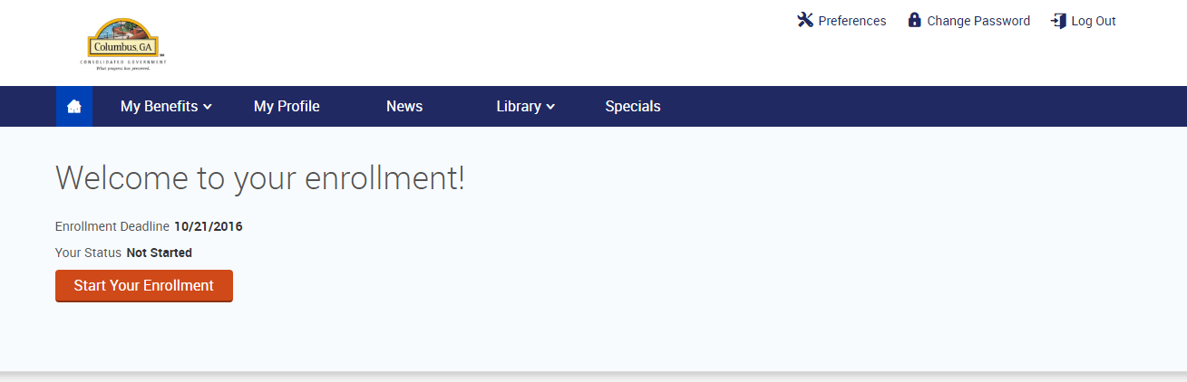

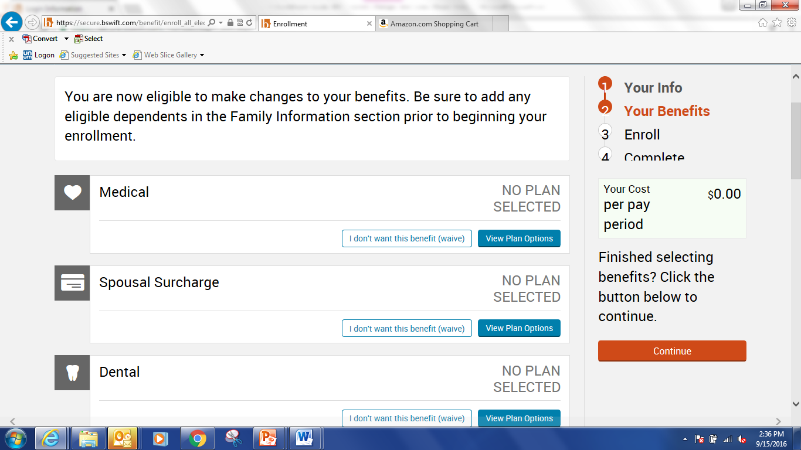
Enrollment Portal
From the Home Page Click on the Start Your Enrollment link, to begin the election process
To choose or change your current election, select the View Plans button for the corresponding benefit.

Slide 8
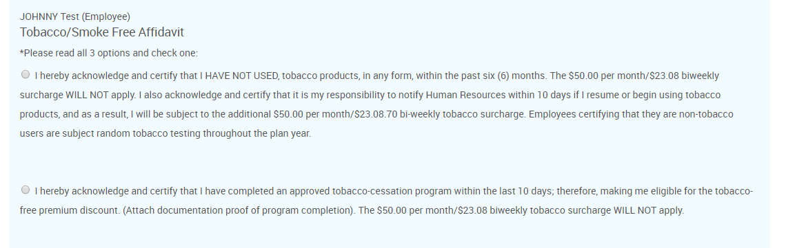
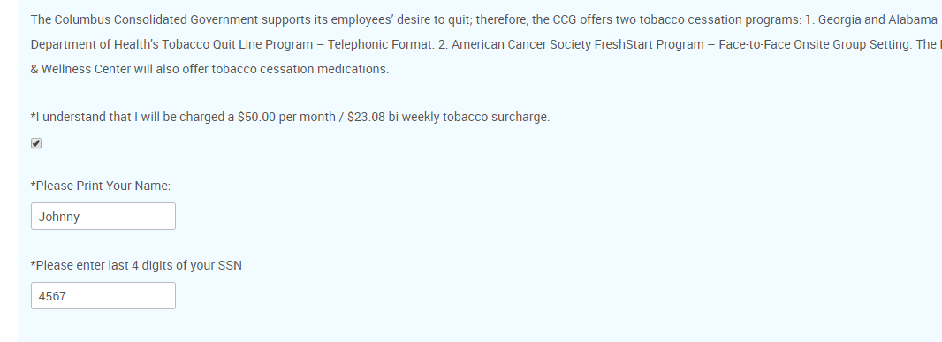
Enrollment Portal
Every employee must answer the tobacco attestation questions. By typing your name and the last four digits of your social security number you are agreeing that you are answering truthfully and that you understand the consequences of providing false information.

Slide 9
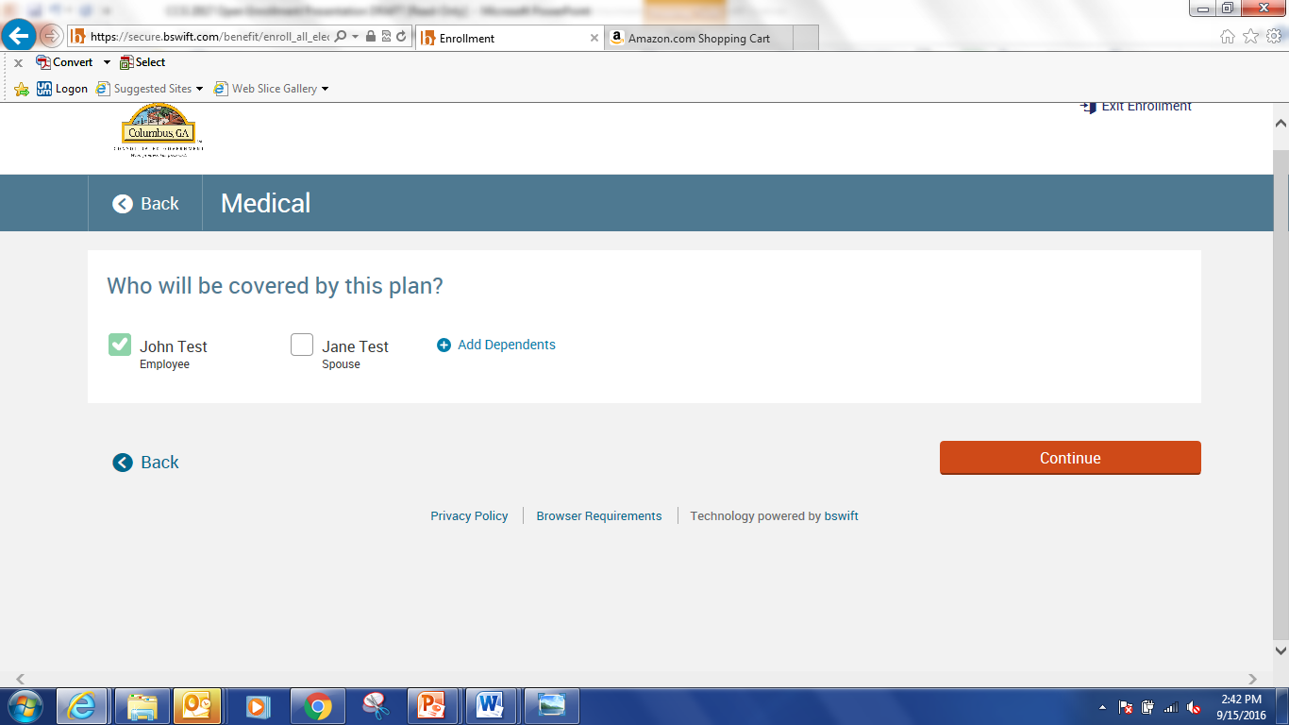
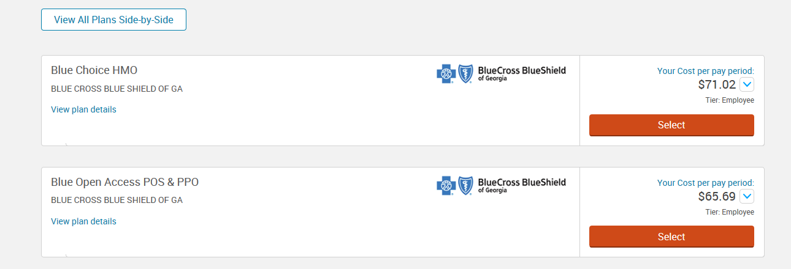
Enrollment Portal
Select the dependents you wish to cover under that particular benefit plan. Then click on the Continue button.
Click on View Plan Details to see details for the corresponding plan. After making a decision, choose the appropriate tier using the drop down menu, then click the Select button under the chosen plan.

Slide 10
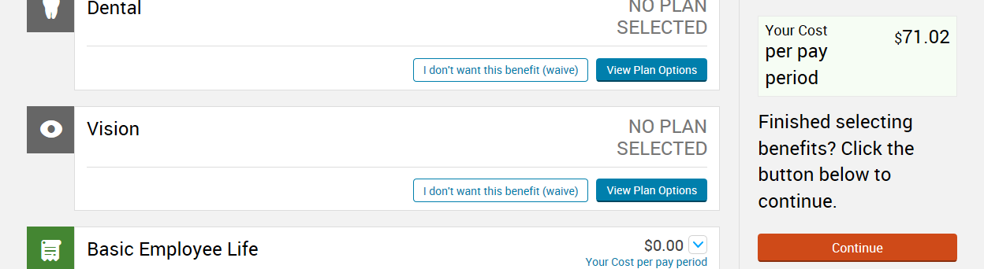
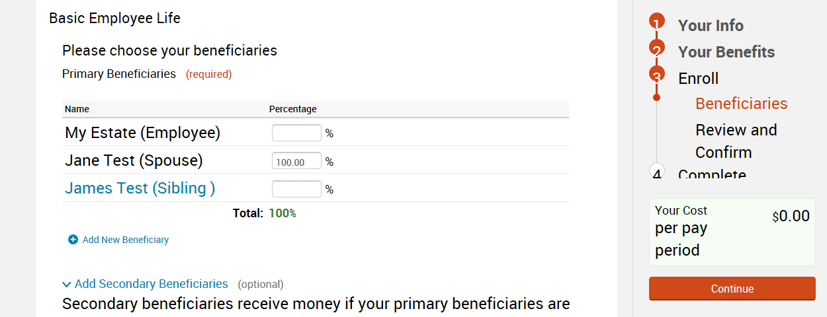
Enrollment Portal
Repeat this process for all remaining benefits. Please take note that your per pay period deductions will total on the right hand side as you continue through the enrollment process. Once you have finished selecting benefits, click the Continue button on the right hand side.
Make your beneficiary designations or confirm your current designations, and once finished click on the Continue button.

Slide 11
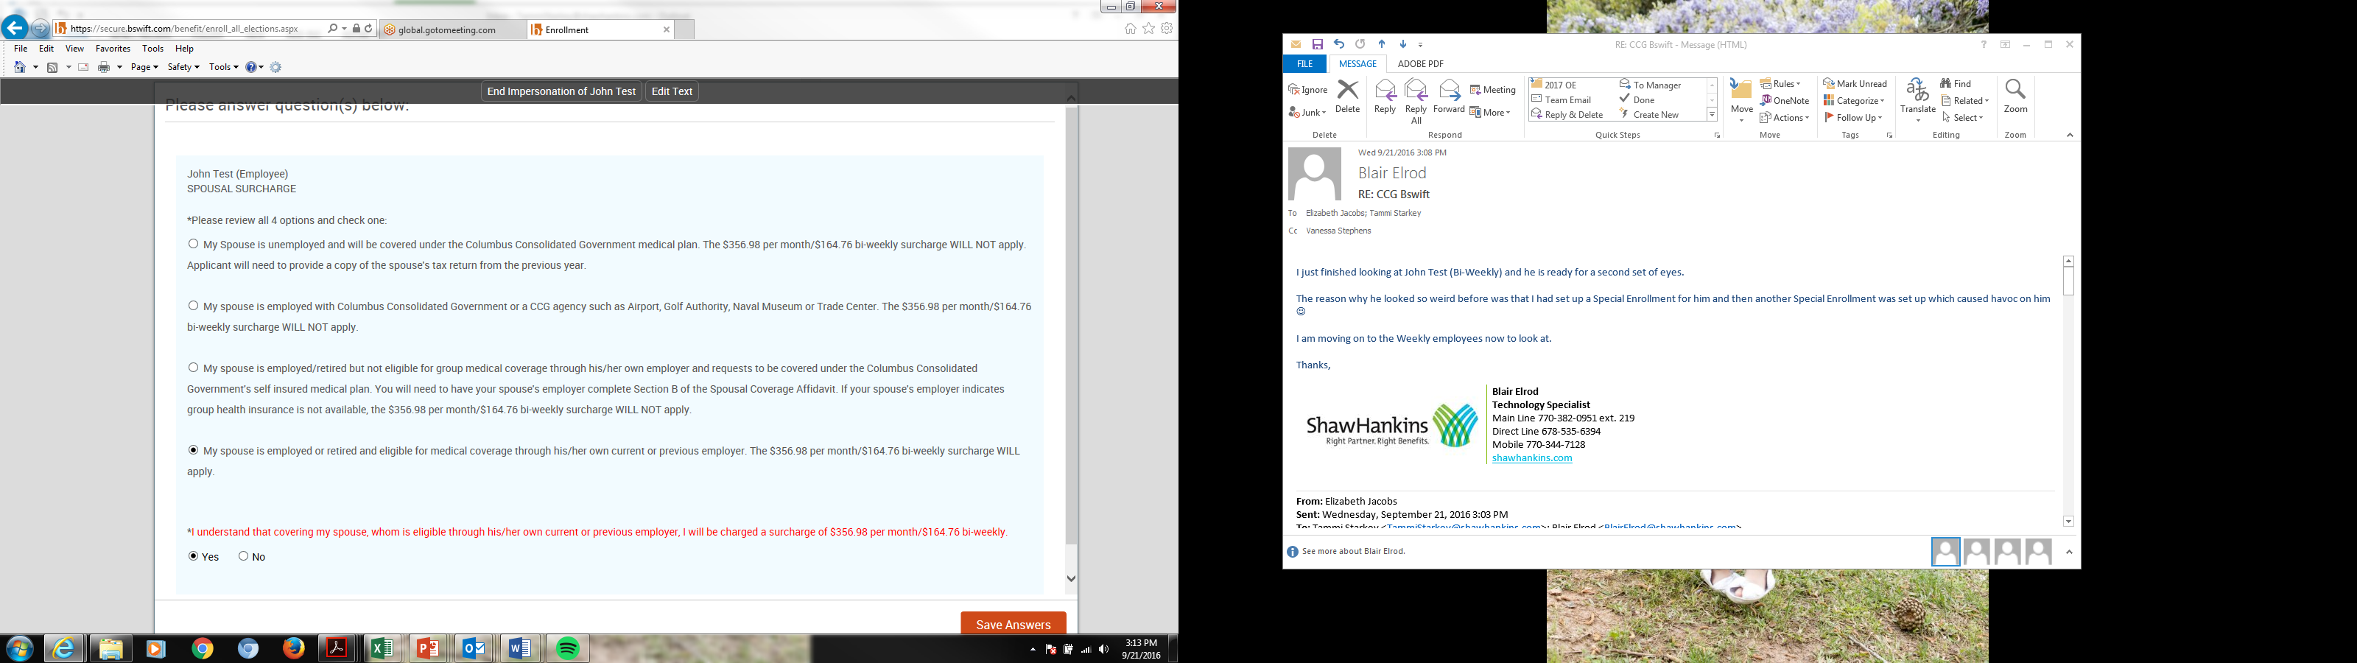
Enrollment Portal
You will complete the Spousal Affidavit for the medical plan spousal surcharge within the bswift enrollment portal

Slide 12
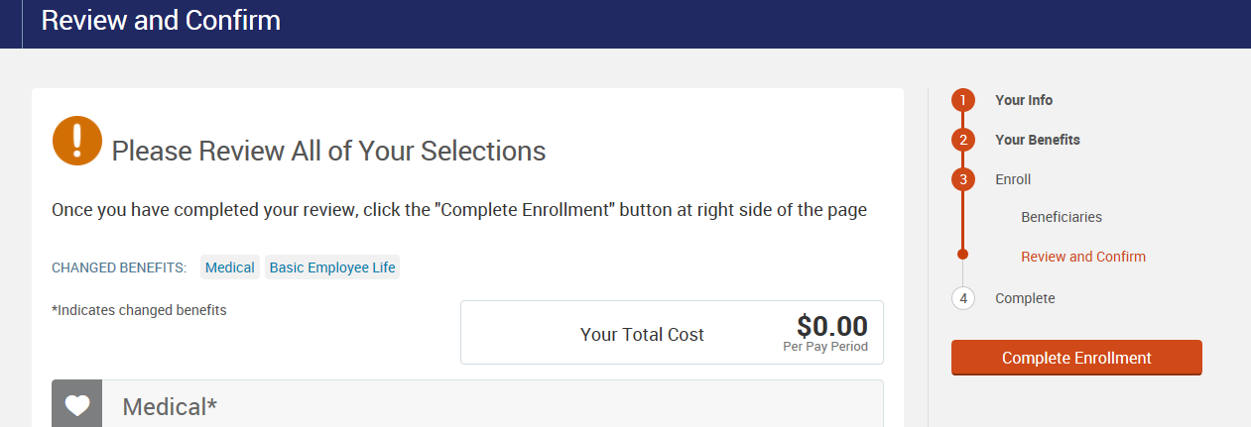
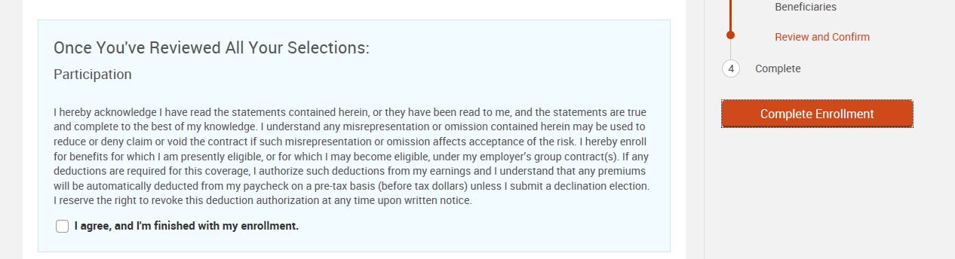
Enrollment Portal
Review all your selections for accuracy. Once you have completed your review, click inside the box next to I agree and I’m finished with my enrollment. Next click on the Complete Enrollment button.

Slide 13
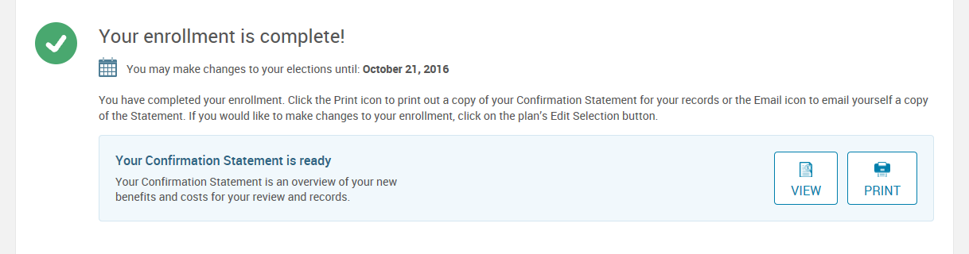
Enrollment Portal
Once you have successfully completed your enrollment, you will see the confirmation above.
You will now have the option to view, print, or email your benefit confirmation statement.
13

Slide 14
2024 Open Enrollment Assistance
If you wish to schedule an appointment with a NFP Benefit Counselor, please visit https://otnutaw5nc.timetap.com.
NFP Benefit Counselors are available to assist virtually and telephonically from October 2– October 20th
You will receive an email confirmation once your appointment has been scheduled. An email reminder 24 hours before your appointment time and a text reminder 1 hour before your appointment time.
Employees will use the telephone number, provided in the email confirmation, to call in at their appointment time.
You can contact the NFP Service Center for assistance, during normal business hours, throughout open enrollment at 1-844-505-9158.
If you meet with a NFP Benefit Counselor to complete your enrollment, please review the emailed copy of your benefit confirmation statement to confirm that your elections are reflected appropriately. There will be no changes outside of open enrollment unless you experience a qualifying life event.

Slide 15
Medical Insurance

Slide 16

Medical Insurance
You will continue to have 2 medical plans to choose from with Anthem Blue Cross Blue Shield of Georgia. Both plans use the national open access network for providers. No referral is required from a PCP in order to see a specialist.
  In-network provider name: Anthem Blue Open Access POS plan
    Should be used when in the state of Georgia.
  Out-of-state provider name: Anthem Blue Choice PPO
    Should be used outside of the State of Georgia
  If you do not make any changes during open enrollment, you will continue under the same plan and with the same level of coverage. *This statement assumes completion of the Tobacco Attestation Form (and no change in tobacco usage), PHA, and Health Coaching (if required).
16

Slide 17
2024 Medical Plan Options
Plan Provisions | Silver Plan | Gold Plan
Lifetime Maximum | Unlimited | Unlimited
Deductible | $2,000 per person $4,000 per family | $1,000 per person $2,000 per family
Coinsurance | 80% plan / 20% member | 90% plan / 10% member
Maximum Annual Out of Pocket Limit | $6,350 per person $12,700 per family | $6,350 per person $12,700 per family
 | Out of Pocket Maximum includes deductible, coinsurance and all copays-Office Visit, Urgent Care, Emergency Room and Prescriptions
Office Visits Primary Care Physician Specialty Care Physician Urgent Care Facilities | $40 copay (free at the HWC) $50 copay $60 copay | $30 copay (free at the HWC) $40 copay $60 copay

Slide 18
2024 Medical Plan Options
Plan Provisions | Silver Plan | Gold Plan
Routine Preventative Care | No Charge | No Charge
Hospital/Inpatient Services | 20% after plan deductible | 10% after plan deductible
Outpatient Services | 20% after plan deductible | 10% after plan deductible
Hospital Emergency Room | $200 per visit copay, copay waived if admitted | $150 per visit copay, copay waived if admitted
Prescription Drugs Generic Brand Non-Formulary Specialty Lifestyle | $15 copay ($30 mail order) $40 copay ($80 mail order) $60 copay ($120 mail order) $150 copay (mail order N/A) 50% (mail order N/A) | $15 copay ($30 mail order) $40 copay ($80 mail order) $60 copay ($120 mail order) $150 copay (mail order N/A) 50% (mail order N/A)

Slide 19
2024 Medical Payroll Deductions (26 per year)
Coverage Tier | Silver Plan w/wellness incentive | Silver Plan w/o wellness incentive | Gold Plan w/wellness incentive | Gold Plan w/o wellness incentive
Cost Without Spousal Surcharges
Employee | $73.03 | $89.40 | $104.65 | $128.11
Employee + Spouse | $137.29 | $168.07 | $196.74 | $240.84
Employee + Child(ren) | $127.82 | $156.46 | $183.16 | $224.20
Family | $202.31 | $247.66 | $289.90 | $354.86
These rates do not include the $75 monthly/$34.62 bi-weekly tobacco surcharge nor do they include the spousal surcharge.
19

Slide 20
2024 Wellness Program
Employees can complete a Personal Health Assessment (PHA) and if required, based on the results of the PHA, attend health coaching sessions to earn a wellness incentive that will leave the payroll deductions for medical coverage the same.
Employees that are found NOT to have any moderate to high-risk health factors, based on the results of the PHA, will automatically complete their participation in the wellness program and will not have any increase to their medical payroll deductions.
Employees that are found to have moderate to high-risk health factors will have the ability to attend health coaching sessions to complete their participation and avoid any increase to the payroll deductions for medical coverage.
Employees can also complete a Personal Health Assessment and receive a certificate for 1 Wellness Day.
Your Wellness Day certificates must be redeemed before December 31, 2024.
20

Slide 21
Tobacco Surcharge
A tobacco surcharge of $75 per month/$34.62 per pay period will apply to all employees that certify they are a tobacco user or fail to complete the Tobacco Attestation Form
Employees will have access to a free cessation program and can avoid the surcharge by completing the program. Once completed CareATC will notify HR so you will not be charged the surcharge.
Within one month of providing your certificate of completion to Human Resources, any surcharge premiums you have been deducted since January 1st, 2024, will be refunded.

Slide 22
Dental Coverage

Slide 23
2024 Dental Plan Option
Administered by Anthem BCBS
Plan Provisions | Low Plan | High Plan
Deductible (cal. Year) Single Family Max | $50 $150 | $50 $150
Annual Benefit Max | $1,000 calendar year | $1,500 calendar year
Diagnostic/Preventive Services | 100% coverage; no deductible | 100% coverage; no deductible
Basic Treatment | 70% coverage; subject to deductible | 80% coverage; subject to deductible
Major Treatment (coverage for implants are now included) | 40% coverage; subject to deductible | 50% coverage; subject to deductible
Orthodontia (child only) | No covered | 50% coverage up to lifetime benefit maximum of $1,500
Benefit Waiting Periods : Employees and dependents, that did not enroll within 31 days of their initial eligibility, will be subject to the following late entrant waiting periods: 6 months- Oral Surgery, 12 months- all other Major Services, 18 months-Ortho.
23

Slide 24
2024 Dental Payroll Deductions (26 per year)
Coverage Tier | Low Plan | High Plan
Employee | $7.95 | $12.24
Employee + Spouse | $15.90 | $27.11
Employee + Child(ren) | $15.11 | $28.14
Family | $23.87 | $43.44
Log on to bcbsga.com and click on Find a Doctor.
Click the Locate Dental Providers link. Next, choose a specialty from the drop-down menu or select ‘no preference’ and then click continue. Enter your search criteria by location or name.
Member/Patient Services:
(855) 397-9269

Slide 25
Vision Coverage

Slide 26
2024 Vision Plan
Administered by Anthem BCBS
Benefit | In-Network | Out-of-Network | Frequency
Vision Exam | $10 copay | Up to $30 allowance | Once every calendar year
Contacts Fitting Standard Premium | Member cost up to $55 10% off retail price | Not covered | Once every other calendar year
Contact Lenses * Elective Medically Necessary | Up to $130 allowance Covered in full | Up to $105 allowance Up to $210 allowance | Once every calendar year
Standard Plastic Lenses Single Vision Bifocal Trifocal | Covered in full after a $10 copay | Up to $25 allowance Up to $40 allowance Up to $55 allowance | Once every calendar year
Frames | Up to $130 allowance; 20% off additional cost | Up to $45 allowance | Once every other calendar year
*Your contact lens allowance must be used at the initial time of service.
**Please note: This plan covers either contact lenses or lenses for your glasses once every other calendar year.

Slide 27
2024 Vision Payroll
Deductions (26 per year)
Coverage Tier | Vision
Employee | $2.73
Employee + Spouse | $4.77
Employee + Child(ren) | $5.18
Family | $7.91

Slide 28
Flexible Spending Accounts

Slide 29
Flexible Spending Account
Administered by Medcom
Flexible Spending Account (FSA)
Unreimbursed Medical Spending Account
Set aside as much as $3,050
Deductibles, co-payments, co-insurance, vision, dental
May rollover up to $610 in unused healthcare FSA funds to next plan year
Members will receive a debit card to use for payment of eligible expenses.
Dependent Care Spending Account
Up to $5,000 if head of household or are married filing joint return
Or up to $2,500 if you are married filing a separate return
Once enrolled, you can monitor your Flexible Spending Account balance by registering at www.medcombenefits.com.
If you have any questions or need additional information, you may call Medcom at 800-523-7542
Note: Re-enrollment is required every year.

Slide 30
FSA Savings Example
Annual Salary: $35,000
Out-of-Pocket Medical/Dental Expenses: $ 1,000/year
Out-of-Pocket Dependent Care Expenses: $ 2,500/year
Without FSA With FSA
Gross Pay $ 35,000 $ 35,000
FSA Contribution (health & dep care) - $ 0 - $ 3,500
Taxable Income $ 35,000 $ 31,500
Taxes (Fed, State, FICA) @ 25% - $ 8,750 - $ 7,875
Out-of-Pocket Expenses - $ 3,500 - $ 3,500
Reimbursement from FSA + $ 0 +$ 3,500 Take-Home Pay $ 22,750 $ 23,625
You save $875 per year!

Slide 31
Healthcare FSA: Eligible Expenses
Co-pays and deductibles
Prescription drugs/medications*
Dental/orthodontia care
Vision care
Disability expenses
Vaccinations
Smoking Cessation Programs
Ineligible Expenses:
Insurance premiums
Non-prescription OTC items*
Cosmetic procedures
Personal hygiene products
Vitamins/supplements
Diet products/food
Health club fees
Non-prescription glasses
*OTC drugs/medications require a prescription or a Prescription Order Form to be eligible for FSA reimbursement.

Slide 32


Dependent Care FSA: Eligible Expenses
Daycare expenses
Before and after school care
Nanny expenses
Nursery school
Registration fees
Elder care
Ineligible Expenses:
Tuition
Transportation
Activity fees/supplies
Field trips
Overnight camp

Slide 33
Basic Life

Slide 34

Employer Paid Life Insurance
Administered by Aflac
Basic Life & Accidental Death and Dismemberment
  Employee = 1.5X Annual Base Income (Maximum of $250,000)
  The county provides this benefit at no cost to you.

Slide 35
Voluntary Term Life

Slide 36
Voluntary Term Life Insurance
Administered by Aflac
Benefit | Coverage
Employee Voluntary Life/AD&D | You can purchase coverage in increments of $10,000 up to a maximum of $500,000. New Hires: You will have a guaranteed issue (GI) amount of $200,000. Employee elections over GI will require Evidence of Insurability.
Spouse Voluntary Life/AD&D | You can purchase coverage in increments of $2,000 to a maximum of $10,000 New Hires: You will have a guaranteed issue amount of $10,000.
Child(ren) Voluntary Life | You can purchase coverage in increments of $2,000 to a maximum of $10,000. New Hires: You will have a guaranteed issue amount of $10,000.
Annual Enrollment | During Open Enrollment employees already enrolled in Voluntary Term Life can increase coverage up to the guaranteed issue amount of $200,000 without completing an Evidence of Insurability Form.

Slide 37
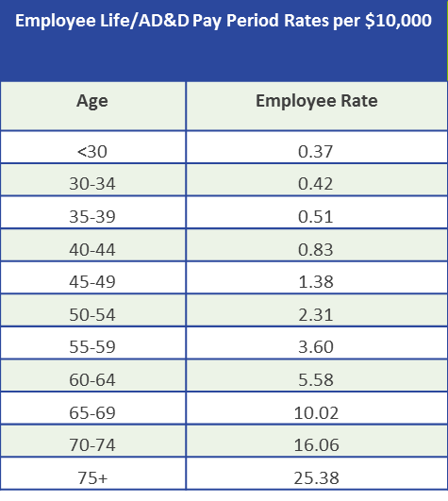
Voluntary Term Life Insurance
Important Terms to Understand
Evidence of Insurability: Evidence of Insurability is a request to verify good health and is often in the form of a questionnaire. This is required when you are requesting insurance that is over the guaranteed issue amounts or if you are enrolling after your initial enrollment.
Guarantee Issue: Guarantee Issue is the amount of life insurance that you can elect without having to provide evidence of insurability. The guaranteed issue period is 31 days from the date you first become eligible for the plan from your date of hire. If you choose not to enroll when you are first eligible and enroll at a later date, the entire amount of insurance will be subject to evidence of insurability.
Spouse & Child Life/AD&D Per Pay Period Premium is $0.33 per $2,000 of coverage. (Ex: $10,000 in coverage would cost $1.66 per pay period)

Slide 38
Supplemental Benefits

Slide 39
Whole Life
Administered by Aflac
  Key Features
  Builds Cash Value
      Guaranteed Interest Rate of 4.5%
      Cash Value may be utilized during working years
      Cash Value may be used to purchase smaller “paid up” policy
    Flexibility To Meet Your Needs
      Employee – Coverage Amount up to $100,000
      Spouse – Coverage Amount up to $50,000
      Children (ages 15 days -24 years) – Coverage Amount $10,000
        $1.38 per week and covers all of your dependent children
        A $25,000 coverage amount is also available
    You own the policy
    New Hire Guarantee Issue Amount
      Employee - $50,000
      Spouse - $25,000

Slide 40
Group Critical Illness
Administered by Aflac
Critical Illness Benefits are payable for specified conditions and can help to cover the costs of your treatments and related expenses, regardless of your major medical insurance coverage.
Key Features
  Lump Sum payment at time of Diagnosis
  Benefit amounts available from $5,000 to $50,000 for employee and $5,000 to $25,000 for spouse
  Additional Occurrence Benefits – with 6 months between diagnosis date
  Re-Occurrence Benefit – with 12 months between diagnosis (or 12 months between diagnosis and 12 months treatment free for cancer benefit)
  Each dependent child is automatically covered at 25% of the primary insured amount
Covered Conditions include but not limited to:
- Heart Attack - Cancer - Renal Failure (end stage)
- Stroke - Major Organ Transplant -Coronary Artery Bypass (25%)
Guarantee Issue Amount
  Employee - $20,000
  Spouse - $10,000
  All existing enrollees may increase their coverage up to the Guarantee Issue Amount at Open Enrollment without answering medical questions

Slide 41
Critical Illness – Wellness Benefit Administered by AFLAC
Colonoscopy
Mammography
Pap smear
Breast Ultrasound
Fasting blood glucose test
Serum cholesterol test
PSA (blood test for prostate cancer)
Chest X-ray
Stress test on a bicycle or treadmill
  After the waiting period (30 days), an insured employee and spouse may receive a maximum of $50 for any one covered health screening test per calendar year. The benefit will be paid regardless of the results of the test. Payment of this benefit will not reduce the critical illness benefit payable under your certificate. This benefit is not paid for Dependent Children. Screening tests include, but are not limited to:

Slide 42
Hospital Indemnity
Administered by Aflac
Benefit | Coverage
HOSPITAL CONFINEMENT BENEFIT (up to 180 days per confinement) | $200 per day
HOSPITAL INTENSIVE CARE BENEFIT (30-day max for any one period of confinement) | $200 per day
SURGICAL AND ANESTHESIA BENEFITS | Surgery up to $2,000; Anesthesia up to $500
OUT-OF-HOSPITAL PRESCRIPTION DRUG BENEFIT | $10 with a 5-prescription maximum per year per covered person
HOSPITAL EMERGENCY ROOM/PHYSICIAN BENEFIT (MEDICAL FEES BENEFIT) If a covered person is injured in a covered accident or has treatment as the result of a covered sickness, we will pay the benefit as shown for a maximum benefit of $50 based on the following: $50 – Physician (per visit) / X-ray (per visit) $25 – Laboratory fees (per visit) / Injections/medications (per visit) Not to exceed a maximum of $50 per visit. | Up to a maximum of $50 per visit Maximum $250 per covered person per calendar year Maximum $1,000 per Family per calendar year
WELL BABY CARE BENEFIT | $25 per visit
Additional Features:
• Benefits are paid directly to you unless you choose otherwise.
• Coverage is available for you, your spouse, and dependent children.
• Coverage is portable. That means you can take it with you if you change jobs or retire (with certain stipulations)
• Fast claims payment. Most claims are processed in about four days.
• Late enrollees must answer health questions

Slide 43
Telemedicine Benefit
Administered by New Benefits
MeMD gives members and their families access to medical assistance via telephone or web, any time, day or night at no cost. When primary care is not available, during travel or after-hours, MeMD’s national network of US-licensed, board-certified medical providers is available to diagnose and prescribe certain medications when medically necessary for common, acute conditions.
Additional Benefits Include:
Online Wellness
Worklife Services
Pharmacy
Following your enrollment in the plan, you will receive a packet of information containing an ID card. You will be instructed to go online and register your account and list all eligible family members. Registering before receiving services will greatly reduce the wait time upon initial use.
$6.12 Per Month

Slide 44
Employee Assistance Program
Administered by Pastoral Institute
Columbus Consolidated Government provides confidential counseling sessions at Pastoral Institute for you and your family at no cost to you.
How do I set up an appointment for counseling?
In the Columbus, GA area call 706-649-6500. When you call mention the name of your employer (Columbus Consolidated Government) and that you are using your EAP benefit.
How many EAP sessions do I have?
Employees have access to six free visits and the spouse/children have six free visits for a total of 12 visits per year.
Will management at my company know I’m going to counseling?
No. Neither your name nor SSN is given to your company.
What are the qualifications of the Counselors?
All of our counselors are licensed and credentialed mental health professional s, including psychologists, licensed professional counselors, marriage and family therapists, social workers and pastoral counselors.
What do I do if I have an emergency situation when you aren’t open?
If you are suicidal, tell someone in your family immediately. You may also dial 911 to help get you to a safe place. If you have an existing relationship with a counselor, call our Counseling Center at 706-649-6500. The Pastoral Institute and its affiliates have a 24/7 on-call emergency service.

Slide 45
Medicare Information
I’m turning 65 this year and still actively working.
What do I need to do?
If you’re turning 65 this year you’ll be getting a Medicare Enrollment kit from CMS, giving you the option to enroll in Medicare Parts A, B as well as Medicare Part D. You’ll be getting the kit 60 to 90 days before your birthday.
Please read the Medicare materials carefully. It helps you to know all you can when you make a decision about enrolling in Medicare.
If you’re an active employee and you get health insurance through Columbus Consolidated Government, this coverage will be your primary insurance. Medicare will be your secondary coverage.
Your coverage as an active employee is considered Creditable Coverage for Medicare Parts B and D. As long as you’re enrolled in health coverage through Columbus Consolidated Government as an active employee, you won’t be penalized if you put off enrolling in Medicare Parts B and D until your retirement.
For more information, visit the Medicare website at:
http://www.medicare.gov or contact the Human Resources Department.

Slide 46
Peachcare Information
Eligibility requirements:
- U.S. citizens, certain qualified legal residents, refugees or asylees who reside in
Georgia.
- Age 18 and under (eligible until 19th birthday).
- Uninsured.
- Family income less than or equal to 247% of the federal poverty level, $49,800 for a
family of three and $60,024 for a family of four.
PeachCare for Kids® health benefits include:
* Care from a doctor when your child is sick
* Preventive services such as immunizations and regular check-ups
* Specialist care
* Dental care
* Vision care, including vision screenings and eyeglasses
* Hospitalization
* Emergency room services
* Prescription medications
* Mental health care
How much does it cost?
There is no cost for children under age 6. Currently, the cost per month for PeachCare for Kids® coverage is $0 to $36 for one child and a maximum of $72 for two or more children living in the same household. Once you complete the application, information about paying your premium will be displayed.
If you have any questions, please call toll-free at 877-GA-PEACH (427-3224)
or visit www.peachcare.org

Slide 47
Benefit Resource Center
Visit www.columbusga.gov/HR/ to access the Benefit Resource Center
This site contains benefit information, informative videos on each benefit offering, links to important documents and forms, and contact information.

Slide 48
NFP Service Center
The Service Center is available from 8:30 a.m. to 5:00 p.m. Monday through Friday to assist you. We have an after-hours voice mailbox and your call will be returned the next business day.
1-844-505-9158
NFPseCustomerService@nfp.com

Slide 49
Questions?

Slide 50


Slide 51

Columbus Consolidated Government
Health and Wellness Center
Notes:
Hi everyone, my name is XXXXX from CATC to speak to you about the partnership CATC has with Columbus Consolidate Government to offer services within the Columbus Consolidated Government Health and Wellness Center.

Slide 52




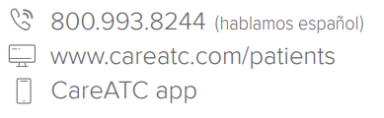
Columbus Consolidated Government
Health and Wellness Center
CCG Health and Wellness Center
2000 10th Ave, Suite 410
Columbus, GA 31901
Mon
Tues
Wed
Thu
Fri
8:30am – 12:30pm | 1:30pm – 5:30pm
7:00am – 12:30pm | 1:30pm – 5:30pm
8:30am – 12:30pm | 1:30pm – 5:30pm
8:30am – 12:30pm | 1:30pm – 5:30pm
7:00am – 12:30pm | 1:30pm – 5:30pm
Three ways to schedule
Notes:
The Columbus Consolidated Gov’t Health and Wellness Center is a full service primary care facility. We are located at 2000 10th Ave, Suite 410. Our hours of operation are M, W, Th from 8:30 to 5:30 with a lunch from 12:30-1:30. On T and F, we are open from 7am-5:30pm, closed for lunch from 12:30-1:30. There is no copay, no deductible, no coinsurance, or expense of lab work or generic medications at your visit when utilizing the HWC. We have 3 ways you can schedule an appointment….Visit careatc.com/patients to log into the patient portal, download the CATC app on Android or Apple app stores, or call 800-993-8244 to schedule your visit today.

Slide 53

Notes:
Hi, I am XXXX a XXX at the CCG Health and Wellness Center. The Health and Wellness Center currently staffs 2 Nurse Practitioners- Collette Greer Daniel and Valerie Little, 1 MD- Dr. Jason Buchanan, and 1 Registered Dietitician-Susan Williams to serve you as your providers. Each provider brings their own wealth of knowledge and experience to the Health and Wellness Center to serve the population with high quality primary care and chronic disease management.

Slide 54













Who is Eligible?
Anyone enrolled in the CCG Health Plan
ACUTE CARE
HEALTH COACHING
MINOR INJURIES
Employees​
Dependents includes spouses and children (ages 4+*)
Retirees
PHYSICALS
DIABETES MANAGEMENT
TOBACCO CESSATION
No-Cost Primary Care
ASTHMA
Quick and easy appointments 24/7 Scheduling through the patient portal and
CareATC mobile app
CHRONIC CONDITION MANAGEMENT
HIGH BLOOD PRESSURE
VACCINATIONS/ LABS
HIGH CHOLESTEROL
Less wait time, face time with your medical provider
SPORTS PHYSICALS
ALLERGIES
*Continue to see a pediatrician for well-child visits and immunizations.
Notes:
Hi, am XXX the XXX at CCG HWC to talk about who is eligible to utilize our full service, no cost primary care, as well as what we offer. Those enrolled on the CCG health plan are eligible to utilize the health center. This includes not only employees, but also spouses and dependents ages 4 years old and up, as well as retirees. Children should continue to see their pediatrician for well child visits, as well as immunizations. We offer chronic disease management such as diabetes management, acute care, asthma, high blood pressure management, allergies, high cholesterol, physicals, tobacco cessation, sports physicals, labs, as well as health coaching.

Slide 55
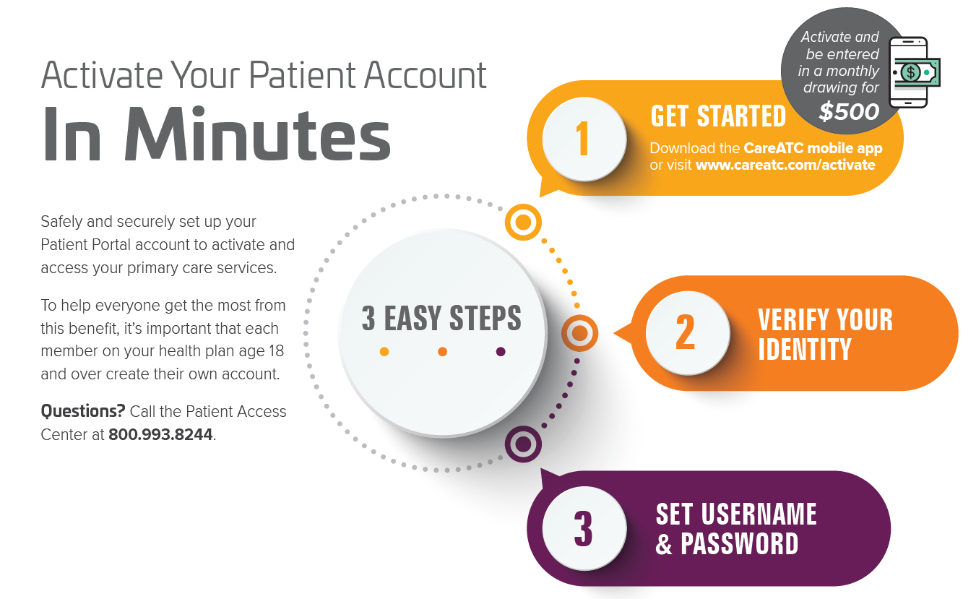
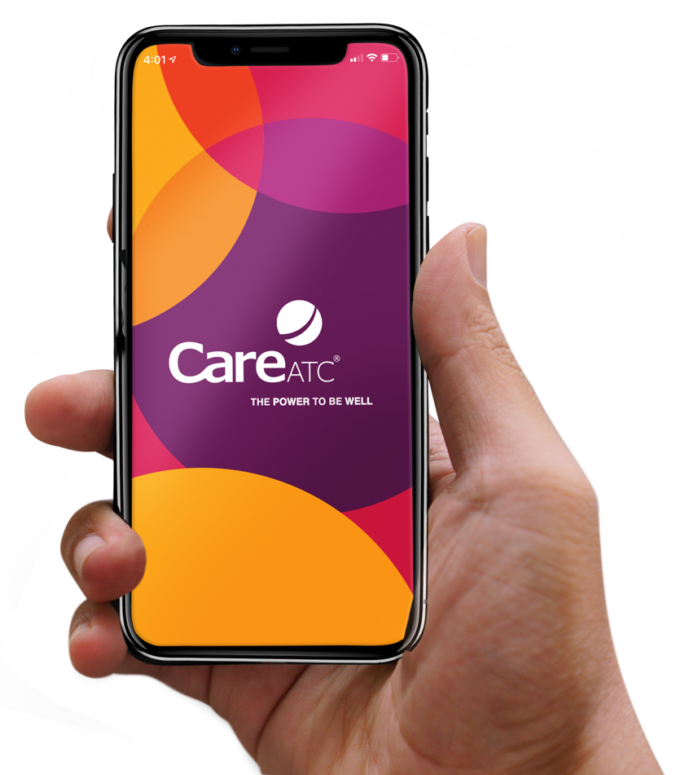
Mobile App
Mobile access to your health
24/7 Appointment Scheduling and Management
Provider Messaging
Medical Records
Complete Patient Forms
Personal Health Assessment Results
Health Education Library
Notes:
Hi, I am XXX the XXX at the CCG HWC to help you set up your patient account. Once you activate your CATC app or patient portal account, you will have access to 24/7 appointment scheduling and management, provider messaging, access to your medical records, ability to complete patient forms, review your Personal Health Assessment Results, and access to the Health Education Library. It is very easy to activate your CareATC account, you will need to download the app or visit the CATC patient portal, verify your identity, and set up your username and password. You will also be entered into a monthly drawing of $500 by activating your account!

Slide 56









Virtual Primary Care
24/7/365 access to physicians
Easy-to-use platform
Visits via video or telephone
Nationwide network of board-certified physicians
Medical record & Patient Portal integration
No visit copays
Conveniently located within the CareATC Mobile App and Patient Portal
Confidential information prepared for exclusive use by CareATC, Inc. Unauthorized duplication or dissemination is prohibited.
56

Slide 57
Additional Information
Flu Vaccines- Planning to begin in October
    beginning 10/3
Referrals to Columbus Diagnostic Center at no cost to those on a CCG plan
Patient information and results are 100% confidential and HIPAA compliant

Slide 58
Columbus Consolidated Government Wellness Program
Notes:
Welcome to the CCG Wellness program informational session

Slide 59
Who is eligible
to participate in the Wellness Program?
Employees
Spouses
Employees and spouses enrolled in the CCG healthcare plan
Employees must participate to receive the 2024 Wellness Program premium incentive
  (
59
Notes:
Eligibility in the wellness program is open to employees and spouses enrolled in the CCG healthcare plan. Employees must participate to receive the 2023 wellness program incentive

Slide 60
2024 PHA Update
Date: July 10th-Oct 20th
CCG Health and Wellness Center
Times: 7 AM-11:30 AM
Days: Tues/Wed/Fri

Slide 61
Wellness Program Incentives
$25 gift card for covered employees that complete the PHA
Wellness Day Off
Avoid an increase of 22% in health care premiums

Slide 62
To Complete a Personal Health Assessment:
Onsite at the CCG Health and Wellness Center
Non-Covered Employees: Physician Visit
Physician Visit
Visit careatc.com/patients, CATC app, or call 1-800-993-8244 to schedule at the HWC
Walk Ins NOT PERMITTED
Provide lab results and biometrics from your Primary Care Physician
Obtain form from CareATC to give to your Physician
Provide lab results from your Primary Care Physician
Email: PAform@careatc.com
Completed physician attestation forms must be submitted by Oct 20, 2023. Non- covered employees are eligible to earn the Wellness Day Off.
Notes:
Draw date within the PA form must be within the PHA timeframe

Slide 63
Health Coaching

Slide 64

Meet the Health Coach
Amy Spradlin, MA, CHES
Email: amyspradlin@careatc.com
Phone: 706.434.8263
Notes:
Jenn Doud, registered Dietitian, is currently the virtual health coach.

Slide 65
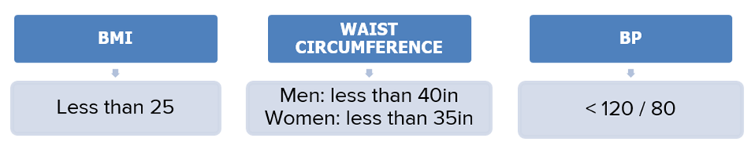
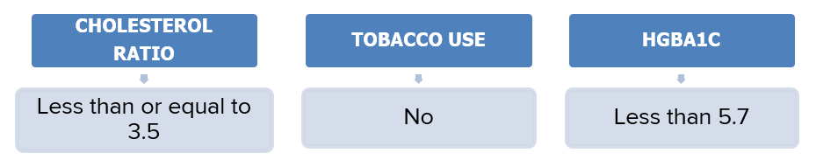
Who is eligible for health coaching?
PHA values with risk indicators greater than the above criteria can be indicative of employee being deemed as coaching eligible.
If you are unable to participate in any health-related activities to earn an incentive, you may be entitled to a Reasonable Alternative and Incentive Waiver. To request a Reasonable Alternative and Incentive Waiver form, please contact Amy Spradlin for more information.
Notes:
Coaching eligibility is based on the shown PHA values with risk indications greater than the above criteria. If you are unable to participate……

Slide 66
Individual Coaching
One-to-One
Virtual, telephonic, or in-person visits
The frequency is determined based upon goal progression and need
Conducted by certified health coach
Targeted and focused on sustainable lifestyle change for risk factor reduction
Participation open to employees that are at risk based on PHA results
  Employee non-participation in the health coaching program will result in a premium increase of 22% for the 2024 plan year.
  You must enroll by 4/1/2024 and attend scheduled appointments to remain in compliance with health coaching throughout 2024 to avoid a premium increase.

Slide 67
Tobacco Cessation Program

Slide 68
Tobacco Cessation Program
All covered employees under the CCG medical plan must complete and sign Tobacco/Smoke Free Affidavit
Surcharge imposed to those EMPLOYEES defined as a "tobacco user."
Once you have completed a tobacco cessation program and provided certification (proof) of program completion, the tobacco surcharge will be removed and a retroactive refund of the tobacco surcharge for that year will be issued.
If you do not successfully complete the program and obtain your certificate of completion or letter of eligibility (proof), the surcharge will be applied the next pay period and it will remain in place for the 2024 calendar year or until you complete a Tobacco Cessation Program.
Be sure to review the Tobacco Cessation Manual for additional details. This will be sent to all employees by HR.

Slide 69
Tobacco Cessation Program Option
Program Option 1: Georgia Department of Health’s Tobacco Quit Line Program and Alabama Department of Health’s Tobacco Quit Line Program – Telephonic Format.
  Register by completing and returning the Quit Line Referral form to HWC or email to amyspradlin@careatc.com
  (deadline and referral form found in Tobacco Cessation Manual)
  • You must request a letter of eligibility at the end of the 5-call program and return to HR within 10 days of receiving it
  If you are non-compliant as stated above, the surcharge will be imposed in January 2024 and will remain in place for the 2024 calendar year or until you have completed the Tobacco Cessation Program and provided a “letter of eligibility”.

Slide 70
Tobacco Cessation Program Option
Program Option 2: CareATC Tobacco Cessation
  Register on Health Passport through CareATC Patient Portal
  4 session webinar
  Be sure to review the Tobacco Cessation Manual for more information

Slide 71
Nicotine Replacement Therapy
Free gum, patches, lozenges through enrollment in the Georgia and Alabama Tobacco Quit Line Program
If interested in prescription tobacco cessation medication, you must schedule an appointment with a provider at the HWC to receive a prescription

Slide 72
Questions?
Questions about the CCG Health and Wellness Center?
Call 800.993.8244 or visit careatc.com/patients to log in to your account, schedule an appointment, and view your medical records. Or use the CareATC mobile app. Search ‘CareATC’ in your Android or Apple app store.
Questions about Health Coaching?
Contact Amy Spradlin, MA, CHES, Health Coach, CareATC, Inc. at 706.434.8263.

