Slide 1
City of Marietta
Confidential
2025 Retiree Benefits Open Enrollment

Slide 2
NFP
• Service Center can answer questions on all benefits
• Available 8:30am – 5:00pm during open enrollment
• NFP Service Center can be reached at 800-994-7429
• Benefit Resource Center –https://shawhankinsbenefits.net/cityofmarietta/
• All elections will be made using the Benefit Election Form provided to you prior to open enrollment

Slide 3
Changes for 2025
Medicare Advantage is remaining with Aetna with an increase in premiums on some options
No change to dental
No change to vision
Basic Life coverage will continue to be provided through MetLife

Slide 4
Open Enrollment
Open Enrollment is October 14 – November 3, 2024
Open Enrollment is your opportunity to make elections for 2025
As a retiree you are eligible to drop dependents, change plans, or drop coverage
As a retiree you are unable to add dependents and/or add benefits that you did not have at retirement or dropped post retirement.

Slide 5
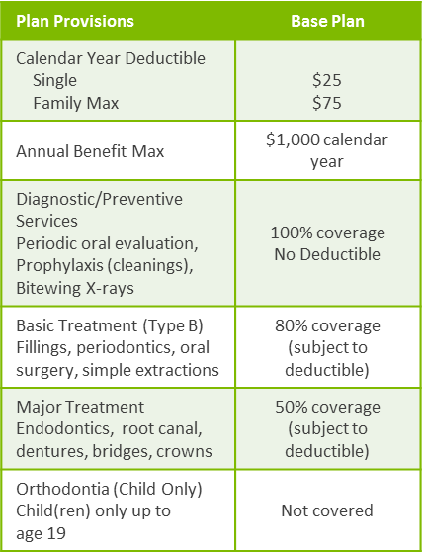
Dental Coverage – Anthem
Plan Provisions | Buy-Up Plan
Calendar Year Deductible Single Family Max | $25 $75
Annual Benefit Max | $1,500 calendar year
Diagnostic/Preventive Services Periodic oral evaluation, Prophylaxis (cleanings), Bitewing X-rays | 100% coverage No Deductible
Basic Treatment (Type B) Fillings, periodontics, endodontics, oral surgery, simple extractions | 80% coverage (subject to deductible)
Major Treatment Dentures, bridges, crowns, Implants* | 50% coverage (subject to deductible)
Orthodontia (Child Only) Child(ren) only up to age 19 | 50% coverage; $1,000 lifetime maximum

Slide 6
Vision Coverage - Avesis
 | Avesis Base Vision Plan |  | Avesis Buy Up Vision Plan
Benefit | In-Network | Out-of-Network | In-Network | Out-of-Network
Vision Exam | $10 copay | Up to $35 allowance | $10 copay | Up to a $45 allowance
Contact Lenses | Allowance | Max Amount | Allowance | Max Amount
Elective Medically Necessary | Up to $130 allowance Covered in full | Up to $110 allowance Up to $250 allowance | Up to $150 allowance Covered in full | Up to $130 allowance Up to $250 allowance
Enhanced Lens Options* | Copayment | Max Amount | Copayment | Max Amount
Single Vision Bifocal Trifocal | Covered in full after a $25 copay | Up to $25 allowance Up to $40 allowance Up to $50 allowance | Covered in full after a $15 copay | Up to $40 allowance Up to $60 allowance Up to $80 allowance
Frames | Up to $50 wholesale allowance; 20% off additional cost | Up to $45 allowance | Up to $80 wholesale allowance; 20% off additional cost | Up to $75 allowance
Laser Vision Correction | $150 one time/lifetime allowance |  | $300 one time/lifetime allowance
Frequency Vision Exam Contact Lenses Standard Lenses Frames | Once every 12 months Once every 12 months Once every 12 months Once every 24 months |  | Once every 12 months Once every 12 months Once every 12 months Once every 12 months

Slide 7
Basic Life & AD&D
City of Marietta provides basic life and AD&D benefit at no cost to you through MetLife
All eligible retirees covered under the Consolidated Retirement Plan receives $25,000
All eligible retirees covered under a retirement plan in effect prior to March 1, 1987 receives $20,000

Slide 8
Questions

Slide 9
NFP.com

