Slide 1
City of Marietta
Confidential
2025 Open Enrollment

Slide 2
Changes for 2025
There will be no changes to your medical and pharmacy plan design, but there will be some increases to cost
There will be no changes to your dental plan design or costs
There will be no changes to your vision plan design or costs
Basic Life will continue to be administered by MetLife

Slide 3
Member Responsibility
• Read Open Enrollment Materials
• Update your personal information and check beneficiaries
• If you wish to make changes, you must either meet with an NFP Benefit Counselor, complete the enrollment form you received by mail and return to nfpSEcustomerservice@nfp.com or to the Benefits Department, or by contact the NFP Service Center by 11:59pm on Sunday, November 3rd. NO EXCEPTIONS!!

Slide 4
Enrollment Guidelines
Open Enrollment is your opportunity to make elections for 2025
The only other time you can make a change to those elections is if you experience a Qualifying Life Event.

Slide 5
Medical and Prescription Coverage

Slide 6
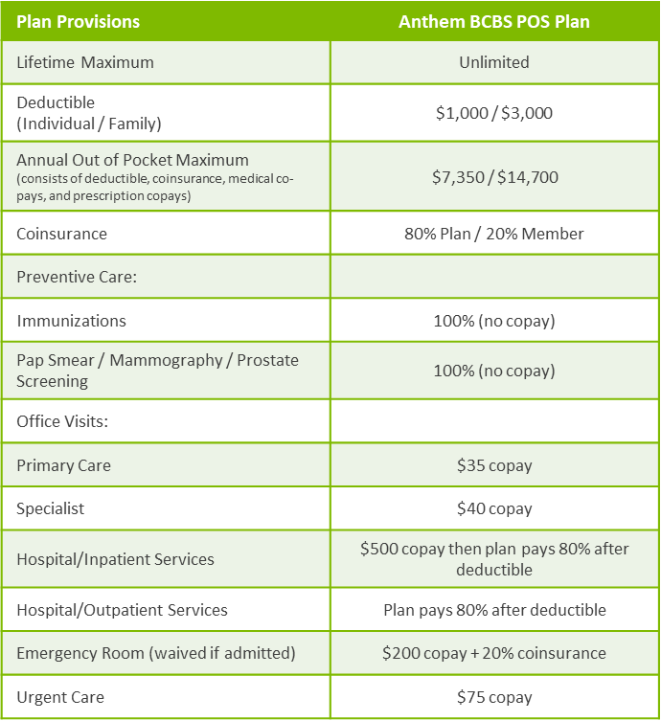
Anthem BCBS POS Plan

Slide 7
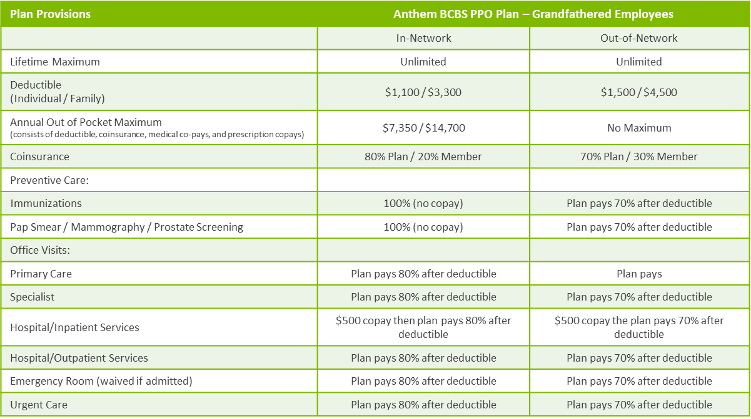
Anthem BCBS PPO Plan (grandfathered)

Slide 8
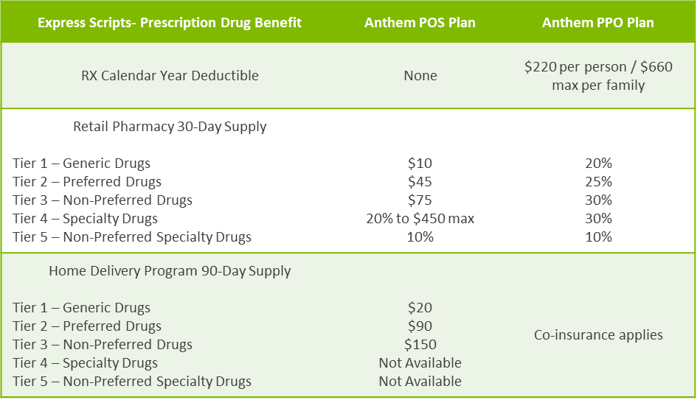
Prescription Drug Plan

Slide 9
Prescription Drug Mail Order
Mail Order Program –You may fill a 90-day supply, of certain medications, through Home Delivery from the Express Scripts Pharmacy.
To start using the Express Scripts Pharmacy Home Delivery program, you will need a new prescription from your doctor.
You may want to ask your doctor to write you a prescription for a 30-day supply of medication to be filled at a retail pharmacy and one for a 90-day supply to be filled through the Express Scripts Pharmacy so that you have medication on hand while your mail order prescription is being filled. Choose one of these options for submitting the new prescription:
Online: Register at www.express-scripts.com and start Home Delivery via ePrescribe, where the doctor sends your prescription electronically to the Express Scripts Pharmacy.
By fax: Ask your doctor to fax your prescription. Your doctor may obtain fax forms by calling 1-888-EASYRX1 (1-888-327-9791) (Only doctors can fax prescriptions).
By mail: Complete an order form for Home Delivery from the Express Scripts Pharmacy. Forms are available at www.express-scripts.com. Return the complete order form, along with your written prescription, to the address on the form.

Slide 10
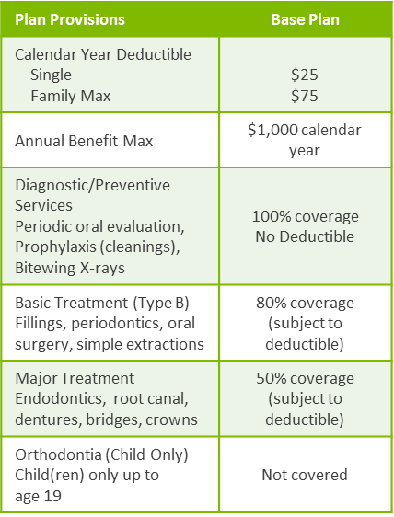
Dental Coverage
Plan Provisions | Buy-Up Plan
Calendar Year Deductible Single Family Max | $25 $75
Annual Benefit Max | $1,500 calendar year
Diagnostic/Preventive Services Periodic oral evaluation, Prophylaxis (cleanings), Bitewing X-rays | 100% coverage No Deductible
Basic Treatment (Type B) Fillings, periodontics, endodontics, oral surgery, simple extractions | 80% coverage (subject to deductible)
Major Treatment Dentures, bridges, crowns, Implants* | 50% coverage (subject to deductible)
Orthodontia (Child Only) Child(ren) only up to age 19 | 50% coverage; $1,000 lifetime maximum

Slide 11
Vision Coverage
 | Avesis Base Vision Plan |  | Avesis Buy Up Vision Plan
Benefit | In-Network | Out-of-Network | In-Network | Out-of-Network
Vision Exam | $10 copay | Up to $35 allowance | $10 copay | Up to a $45 allowance
Contact Lenses | Allowance | Max Amount | Allowance | Max Amount
Elective Medically Necessary | Up to $130 allowance Covered in full | Up to $110 allowance Up to $250 allowance | Up to $150 allowance Covered in full | Up to $130 allowance Up to $250 allowance
Enhanced Lens Options* | Copayment | Max Amount | Copayment | Max Amount
Single Vision Bifocal Trifocal | Covered in full after a $25 copay | Up to $25 allowance Up to $40 allowance Up to $50 allowance | Covered in full after a $15 copay | Up to $40 allowance Up to $60 allowance Up to $80 allowance
Frames | Up to $50 wholesale allowance; 20% off additional cost | Up to $45 allowance | Up to $80 wholesale allowance; 20% off additional cost | Up to $75 allowance
Laser Vision Correction | $150 one time/lifetime allowance |  | $300 one time/lifetime allowance
Frequency Vision Exam Contact Lenses Standard Lenses Frames | Once every 12 months Once every 12 months Once every 12 months Once every 24 months |  | Once every 12 months Once every 12 months Once every 12 months Once every 12 months

Slide 12
Basic Life & AD&D
City of Marietta provides basic life and AD&D benefit at no cost to you through MetLife
All eligible retirees covered under the Consolidated Retirement Plan receives $25,000
All eligible retirees covered under a retirement plan in effect prior to March 1, 1987 receives $20,000

Slide 13
NFP
• Service Center can answer questions on all benefits
• Available 8:30am – 5:00pm during open enrollment
• NFP Service Center can be reached at 800-994-7429

Slide 14
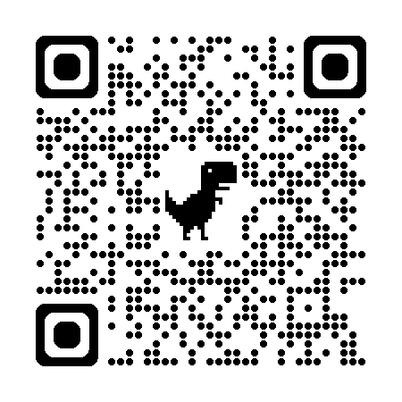
Benefit Resource Center
www.ShawHankinsbenefits.net/cityofmarietta
This site contains benefit information, informative videos on each benefit offering, links to important documents and forms, and contact information.

Slide 15
Questions?

Slide 16
NFP.com

