Slide 1
City of Marietta
Confidential
2025 Open Enrollment

Slide 2
Open Enrollment
• Open Enrollment is October 14 – November 3, 2024
• On-site Enrollment Assistance will be offered from
October 15 – October 24, 2024
• NFP will be available to answer questions and assist with enrollments
• Schedule your appointment at https://agagg9unuq.timetap.com
Date | Location | Time
October 15, 2024 | Council Chambers | 1:00pm - 4:00pm
October 16, 2024 | BLW Electric | 8:00am - 12:00pm
October 17, 2024 | BLW Water | 8:00am - 12:00pm
October 23, 2024 | Public Works Operations Building | 8:00am - 12:00pm
October 22, 2024 – October 24, 2024 | Human Resources Training Room | 8:00am - 4:00pm

Slide 3
Changes for 2025
There will be no changes to your medical, pharmacy, dental, and vision benefits this year for active employees
Basic Life, Voluntary Life, and Disability will continue to be administered by MetLife
No change to the Accident or Critical Illness
The ARAG legal plan will have a slight premium increase and enhanced benefits
Healthcare FSA maximum is now $3,200 and the rollover is $640

Slide 4
Employees’ Responsibility
• Read Open Enrollment Materials
• Update your personal information and check beneficiaries
• Complete your enrollment by going on the on- line enrollment system, meeting with an NFP Benefit Counselor, or by contacting the NFP Service Center by 11:59pm on Friday, November 3rd. NO EXCEPTIONS!!
• Check your January payroll deductions

Slide 5
Enrollment Guidelines
Open Enrollment is your opportunity to make elections for 2025.
To add someone to your benefits you have to provide the following documentation:
Marriage Certificate
Birth Certificate
Date of Birth
Social Security Numbers
The only other time you can make a change to those elections is if you experience a Qualifying Life Event.

Slide 6
Qualifying Life Event
Marriage
Divorce
Birth of Child
Loss of other coverage
Loss of dependent status
You have 31 days from the date of the Qualifying Life Event to notify Human Resources of the change and provide them with appropriate documentation.

Slide 7
Bswift Online Enrollment
Make all elections through Bswift enrollment portal: http://cityofmarietta.bswift.com
Username: first letter of first name, last name, and year of birth
Example: JSmith1972
Password: employee ID number
If you do not make elections through the enrollment portal, your coverage will roll over for the 2025 plan year. The only exception is Flexible Spending. You must enroll in Flexible Spending in order to participate in the plan for 2025.
You will not be permitted to make changes after the open enrollment period ends, unless you experience a qualifying event.

Slide 8
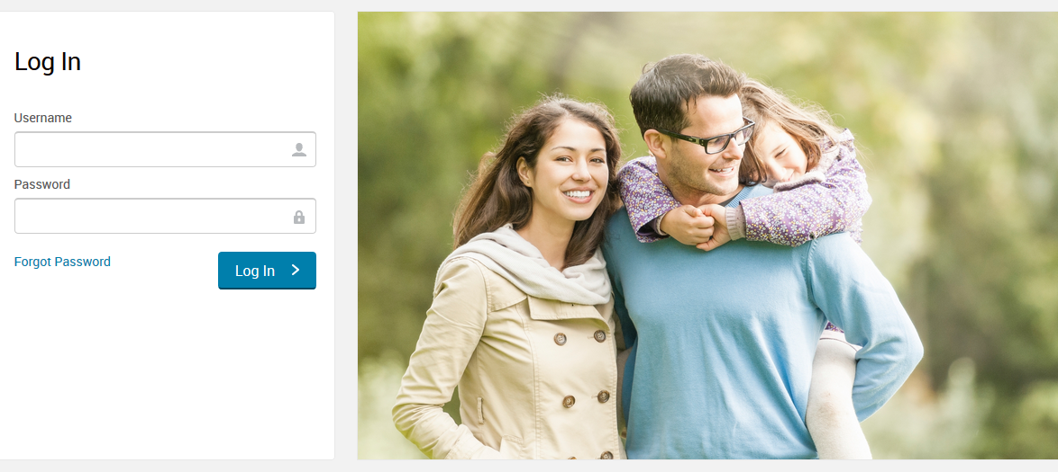
Enrollment Portal

Slide 9
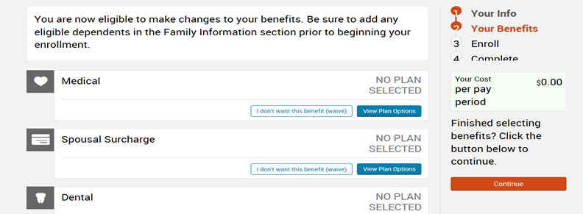
Completing Enrollment

Slide 10
Enrollment Complete

Slide 11
Medical and Prescription Coverage

Slide 12
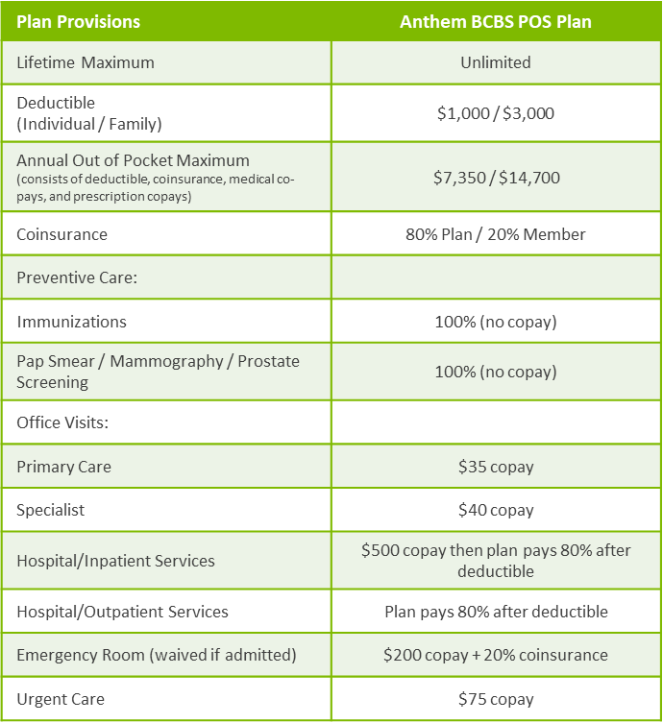
Anthem BCBS POS Plan

Slide 13
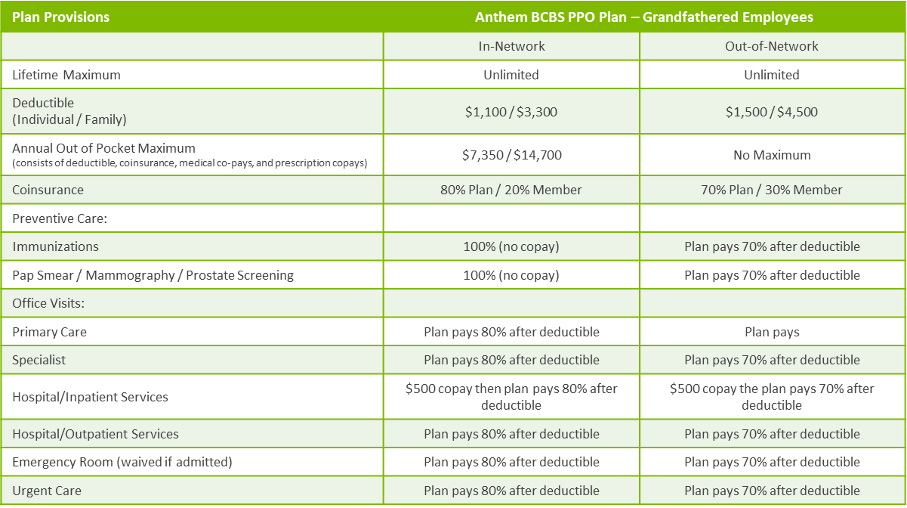
Anthem BCBS PPO Plan (grandfathered)
$300

Slide 14
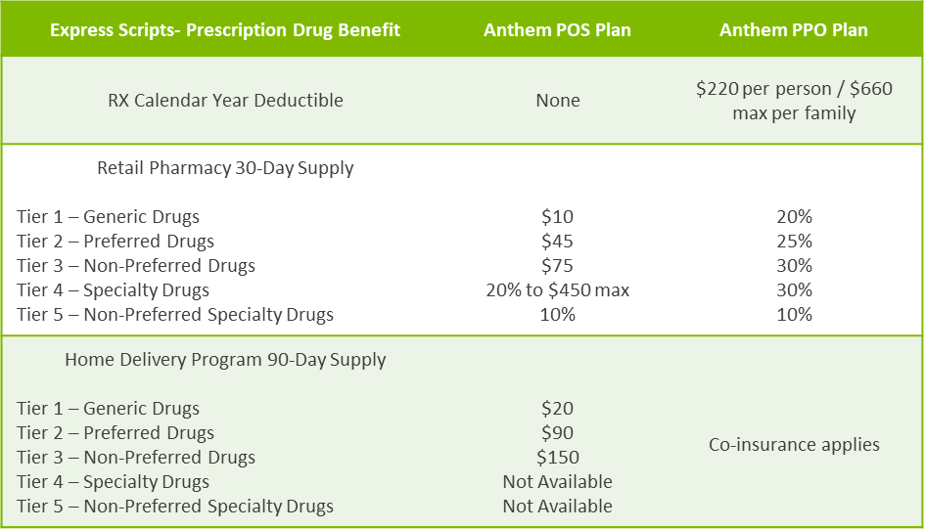
Prescription Drug Plan

Slide 15
Prescription Drug Mail Order
Mail Order Program –You may fill a 90-day supply, of certain medications, through Home Delivery from the Express Scripts Pharmacy.
To start using the Express Scripts Pharmacy Home Delivery program, you will need a new prescription from your doctor.
You may want to ask your doctor to write you a prescription for a 30-day supply of medication to be filled at a retail pharmacy and one for a 90-day supply to be filled through the Express Scripts Pharmacy so that you have medication on hand while your mail order prescription is being filled. Choose one of these options for submitting the new prescription:
Online: Register at www.express-scripts.com and start Home Delivery via ePrescribe, where the doctor sends your prescription electronically to the Express Scripts Pharmacy.
By fax: Ask your doctor to fax your prescription. Your doctor may obtain fax forms by calling 1-888-EASYRX1 (1-888-327-9791) (Only doctors can fax prescriptions).
By mail: Complete an order form for Home Delivery from the Express Scripts Pharmacy. Forms are available at www.express-scripts.com. Return the complete order form, along with your written prescription, to the address on the form.

Slide 16
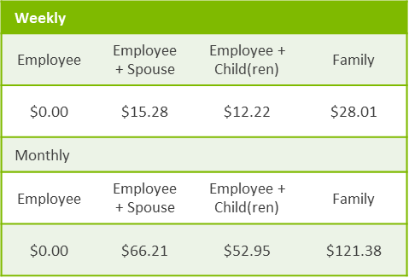
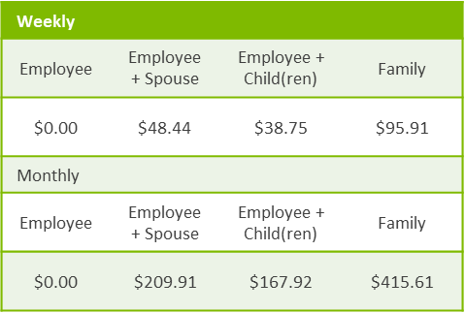
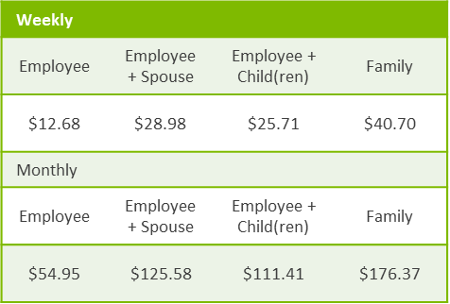
Medical Deductions
POS Plan
Active Employees
Hired Prior to
November 1, 2006
PPO Plan
Active Employees
Hired Prior to November 14, 1996
POS Plan
Active Employees
Hired November 1, 2006 or Later

Slide 17
Health Benefit Waiver Option
Employees may choose to waive health and dental insurance coverage under the City’s health and dental insurance plan, and instead receive up to $500 per year from the City. This amount will be deposited into the Flexible Benefits Reimbursement account in the employee’s name to help pay for qualified out of pocket medical expenses incurred by the employee or family members.
In order to qualify to participate in this plan, the employee must have health insurance coverage from a provider other than the City and complete an affidavit. The City will match your personal contribution into the Flexible Benefits Reimbursement account up to $500. If you do not choose to contribute to the Flexible Benefits Reimbursement account, there will be no match from the City.

Slide 18
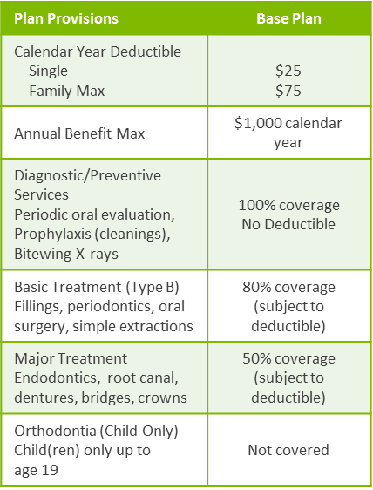
Dental Coverage
Plan Provisions | Buy-Up Plan
Calendar Year Deductible Single Family Max | $25 $75
Annual Benefit Max | $1,500 calendar year
Diagnostic/Preventive Services Periodic oral evaluation, Prophylaxis (cleanings), Bitewing X-rays | 100% coverage No Deductible
Basic Treatment (Type B) Fillings, periodontics, endodontics, oral surgery, simple extractions | 80% coverage (subject to deductible)
Major Treatment Dentures, bridges, crowns, Implants* | 50% coverage (subject to deductible)
Orthodontia (Child Only) Child(ren) only up to age 19 | 50% coverage; $1,000 lifetime maximum

Slide 19
Vision Coverage
 | Avesis Base Vision Plan |  | Avesis Buy Up Vision Plan
Benefit | In-Network | Out-of-Network | In-Network | Out-of-Network
Vision Exam | $10 copay | Up to $35 allowance | $10 copay | Up to a $45 allowance
Contact Lenses | Allowance | Max Amount | Allowance | Max Amount
Elective Medically Necessary | Up to $130 allowance Covered in full | Up to $110 allowance Up to $250 allowance | Up to $150 allowance Covered in full | Up to $130 allowance Up to $250 allowance
Enhanced Lens Options* | Copayment | Max Amount | Copayment | Max Amount
Single Vision Bifocal Trifocal | Covered in full after a $25 copay | Up to $25 allowance Up to $40 allowance Up to $50 allowance | Covered in full after a $15 copay | Up to $40 allowance Up to $60 allowance Up to $80 allowance
Frames | Up to $50 wholesale allowance; 20% off additional cost | Up to $45 allowance | Up to $80 wholesale allowance; 20% off additional cost | Up to $75 allowance
Laser Vision Correction | $150 one time/lifetime allowance |  | $300 one time/lifetime allowance
Frequency Vision Exam Contact Lenses Standard Lenses Frames | Once every 12 months Once every 12 months Once every 12 months Once every 24 months |  | Once every 12 months Once every 12 months Once every 12 months Once every 12 months

Slide 20
Flexible Spending Accounts
Medical Spending Account
Maximum contribution of $3,200
Some eligible expenses - Deductibles, copayments, dental expense, vision services and materials
Dependent Care Spending Account
$5,000 for married couple filing joint income tax returns, $2,500 if unmarried or married and filing separate income taxes
Some eligible expenses - any care of a dependent that allows you and your spouse to work: day care, after school program, in-home care, camps, etc.
You may rollover $640 of funds left in the Medical Spending Account at the end of the year.

Slide 21
Basic Life & AD&D
City of Marietta provides basic life and AD&D benefit at no cost to you provided through MetLife
City Council Employees and Part-Time Appointed Officials: $150,000
Closed Group of Public Safety Employees: $40,000
All Other Employees: 3 x your annual earnings, maximum $300,000*

Slide 22
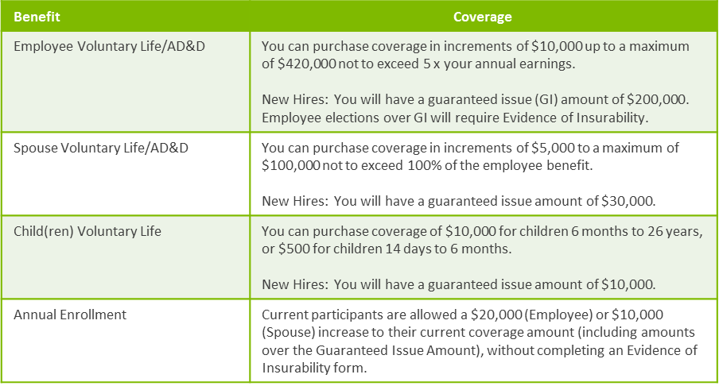
Optional Life Insurance

Slide 23
Short Term Disability
Provided through MetLife
Pays after you are disabled for 14 days
Covers 60% of your salary, up to $2,500 per week
Pays for up to 24 weeks of disability

Slide 24
Long Term Disability
Provided through MetLife
Pays after you are disabled for 180 days
Covers 60% of your salary, up to $5,300 per month
Continues to pay until you can return to work or reach
SSNRA

Slide 25
Legal Services
Coverage is available through ARAG
Access to a nationwide network of attorneys
Work with you in person, over the phone or online on legal issues
Review or prepare documents
Make calls or write letters on your behalf
Represent you in court
Family law, real estate matters, civil damage claims, criminal matters, debt related matters, dispute with a landlord, government benefits, small claims court, tax issues, traffic matters, etc.
Includes ID theft protection-monitoring, restoration, lost wallet service, $1,000,000 in insurance

Slide 26
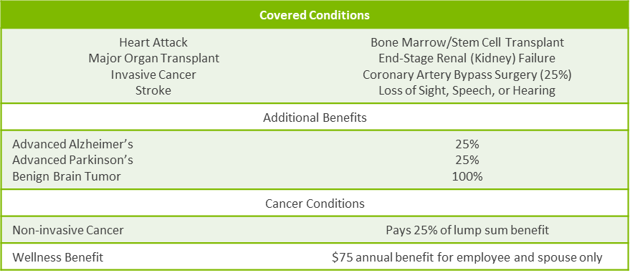
Critical Illness

Slide 27
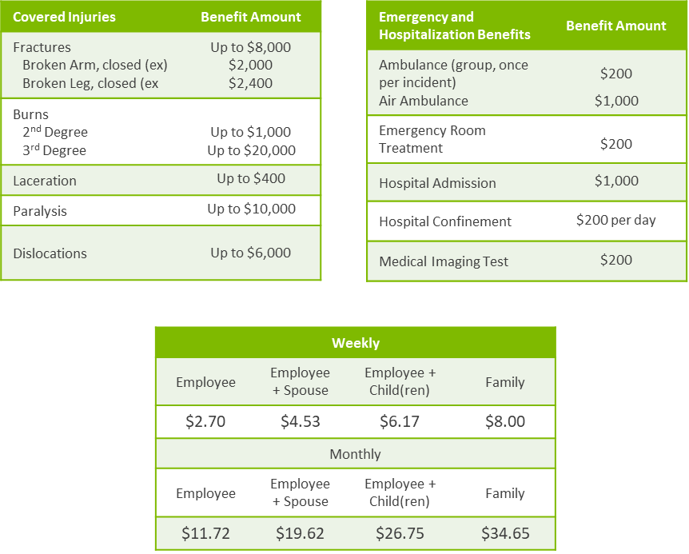
Accident

Slide 28
Employee Assistance Programs
LifeWorks through MetLife
Unlimited telephonic support for a broad range of topics
5 phone or video consultations, for you and your household members, per issue, per year
Easy to use educational tools and resources, online and through a mobile app:
Search “LifeWorks” on iTunes App Store or Google Play. Log in with the user name: metlifeeap and password: eap
Grief counseling services:
Financial and legal consultation
three face-to-face, telephonic, or video counseling sessions per grief or loss event
Receive unlimited access to a customized global Grief Counseling services website and mobile application

Slide 29
Employee Assistance Programs
FEI Workforce Resilience
Up to 3 face-to-face counseling sessions per eligible person per year at no cost to you
24/7 phone access to live counselors, 365 days a year for assessment and referral
Website access at www.feieap.com
Legal services; one consultation per legal matter
Financial services; one consultation per financial matter

Slide 30
Discounted Auto, Home and Pet Insurance
All employees are eligible to enroll in discounted auto, home, and pet insurance through Farmers GroupSelect.
You may receive additional information regarding these benefits by reaching out directly to Farmers GroupSelect.

Slide 31
NFP
• Service Center can answer questions on all benefits
• Available 8:30am – 5:00pm during open enrollment
• NFP Service Center can be reached at 800-994-7429

Slide 32
Benefit Resource Center
www.ShawHankinsbenefits.net/cityofmarietta
This site contains benefit information, informative videos on each benefit offering, links to important documents and forms, and contact information.

Slide 33
Questions?

Slide 34
NFP.com

